Slide 1
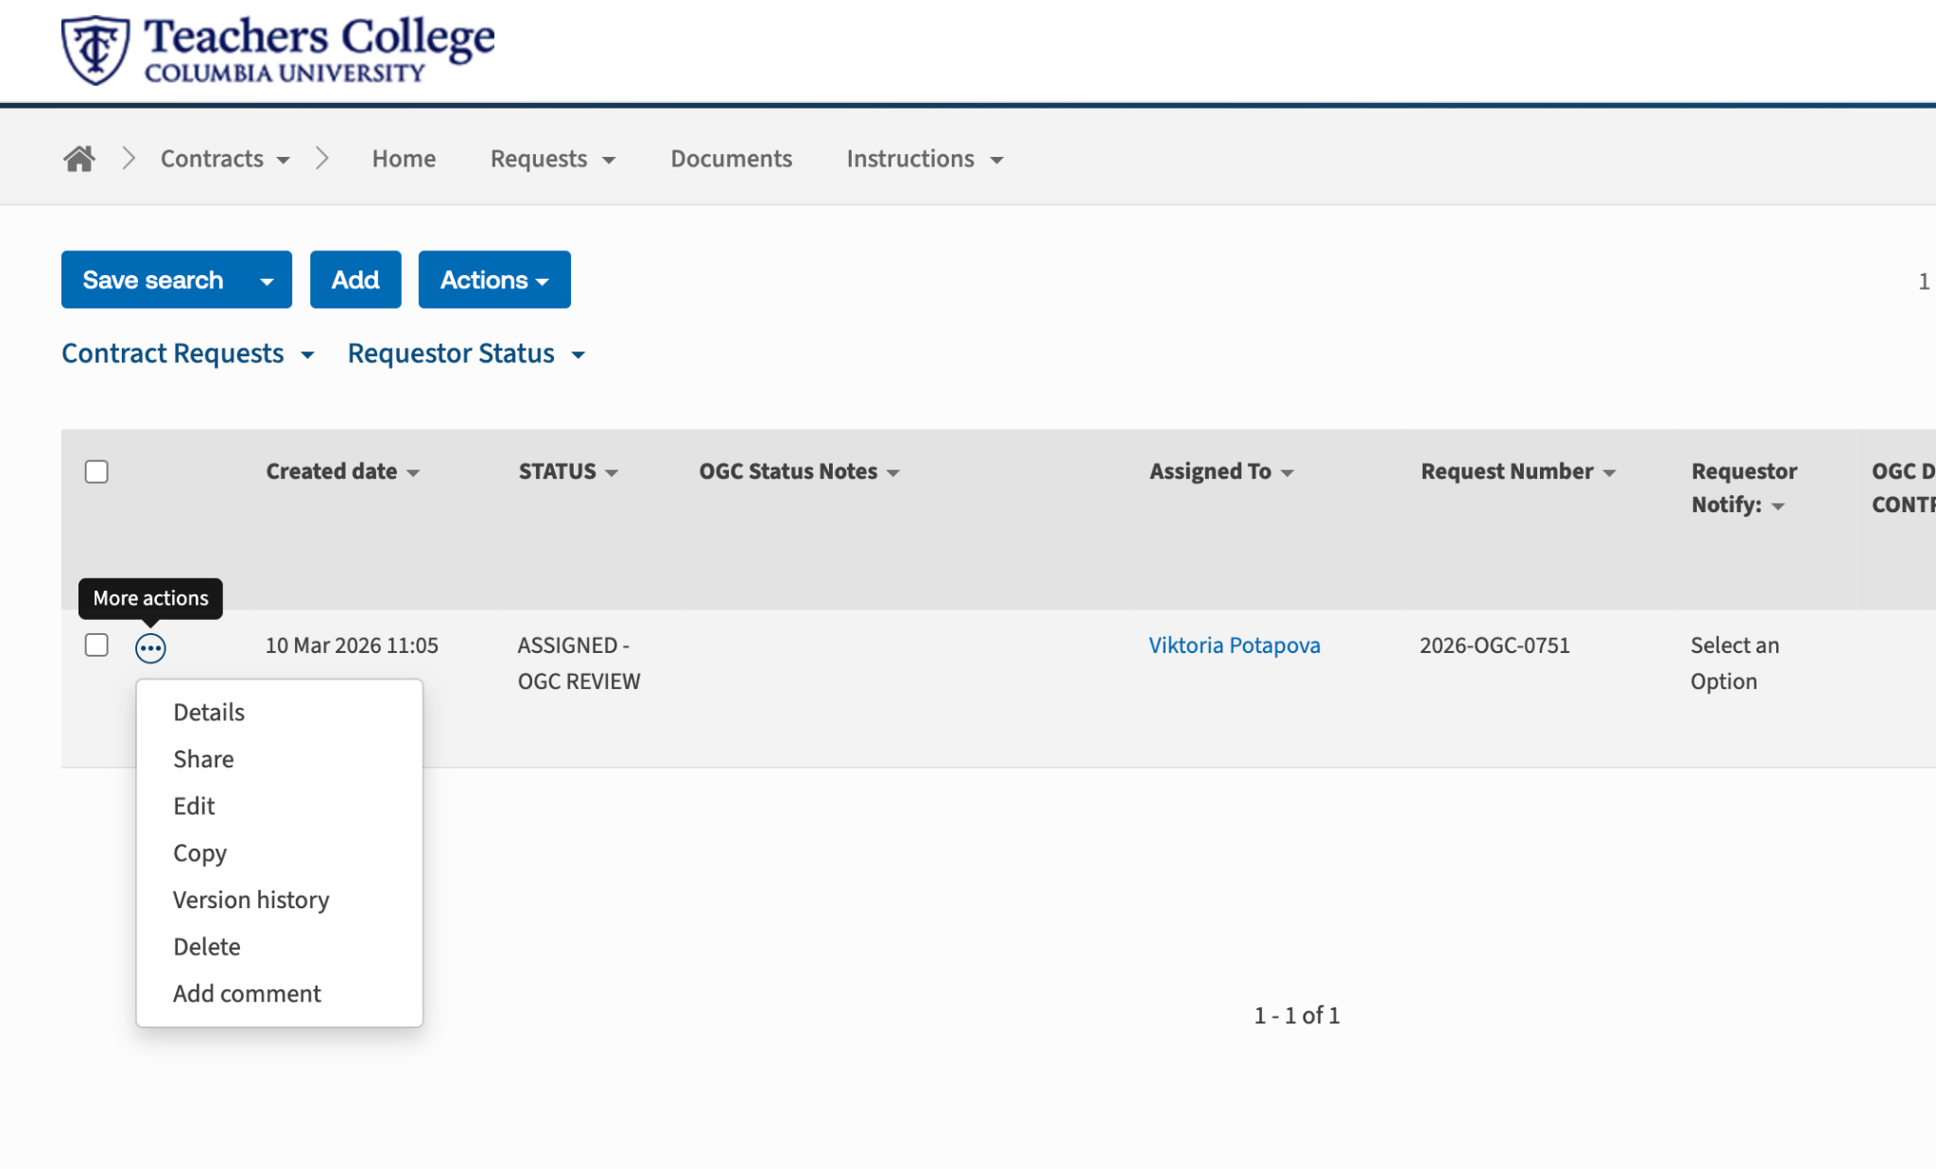
Select the 3 dots and press ‘Edit’

Slide 2
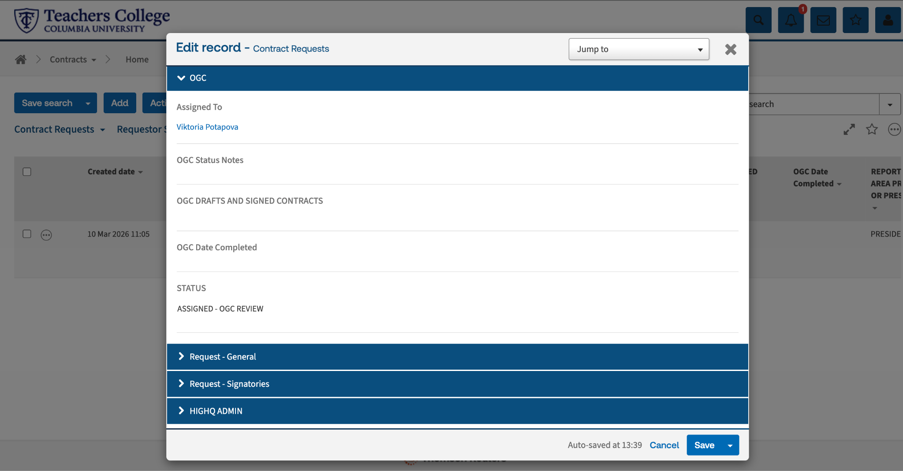
Select ‘Request General’

Slide 3
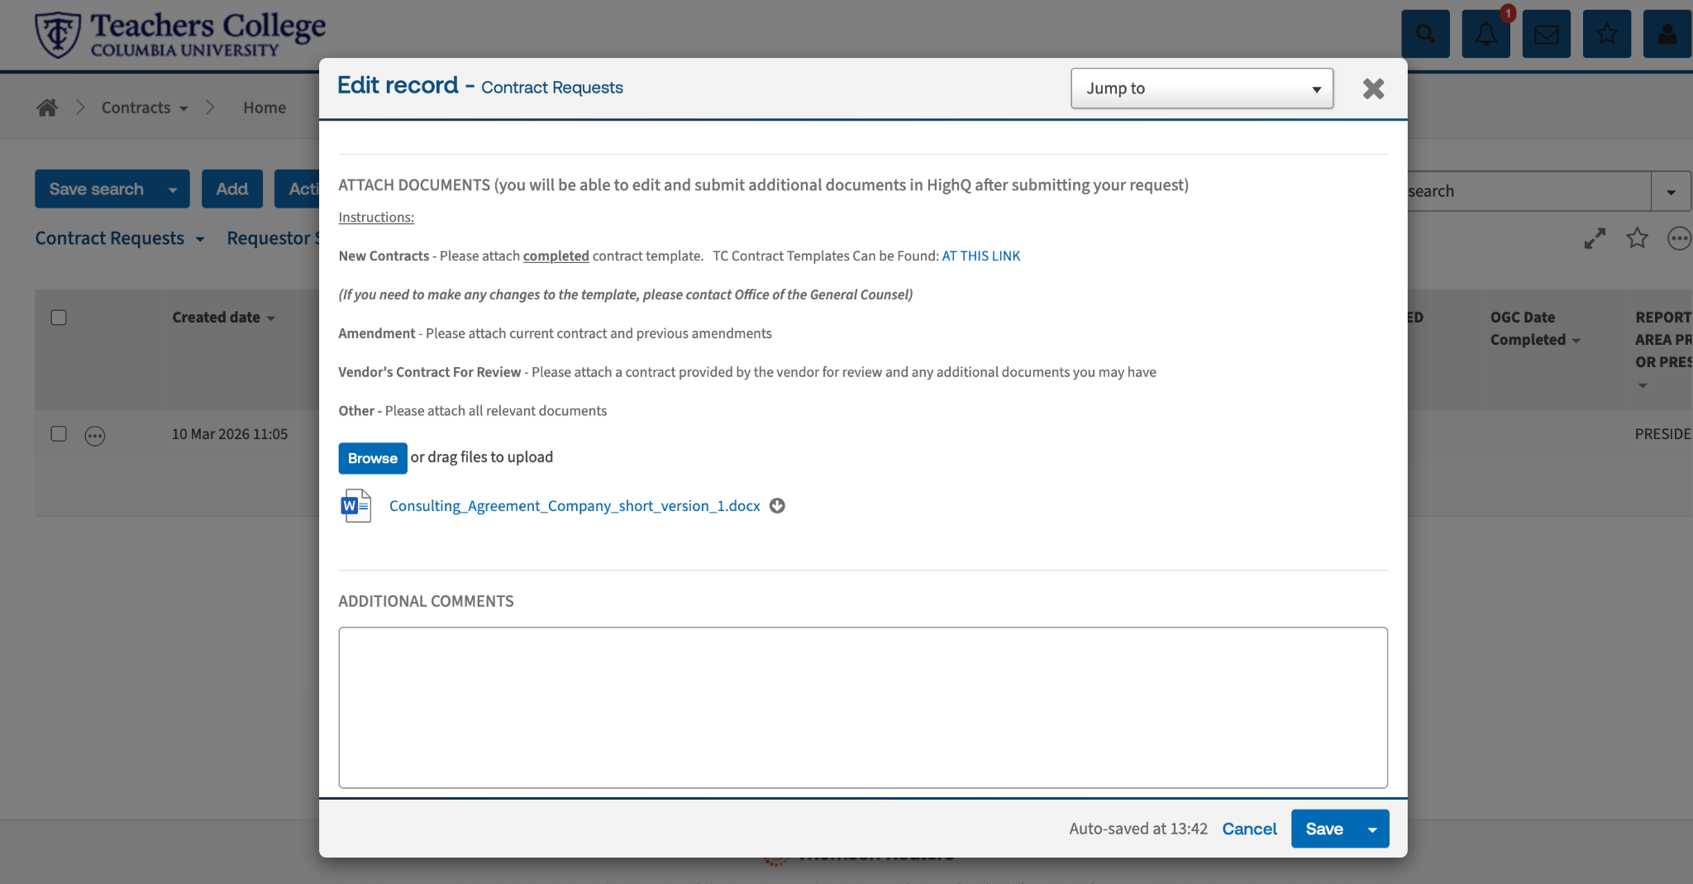
Scroll to ‘Attach Documents’ and click on the document you wish to edit

Slide 4
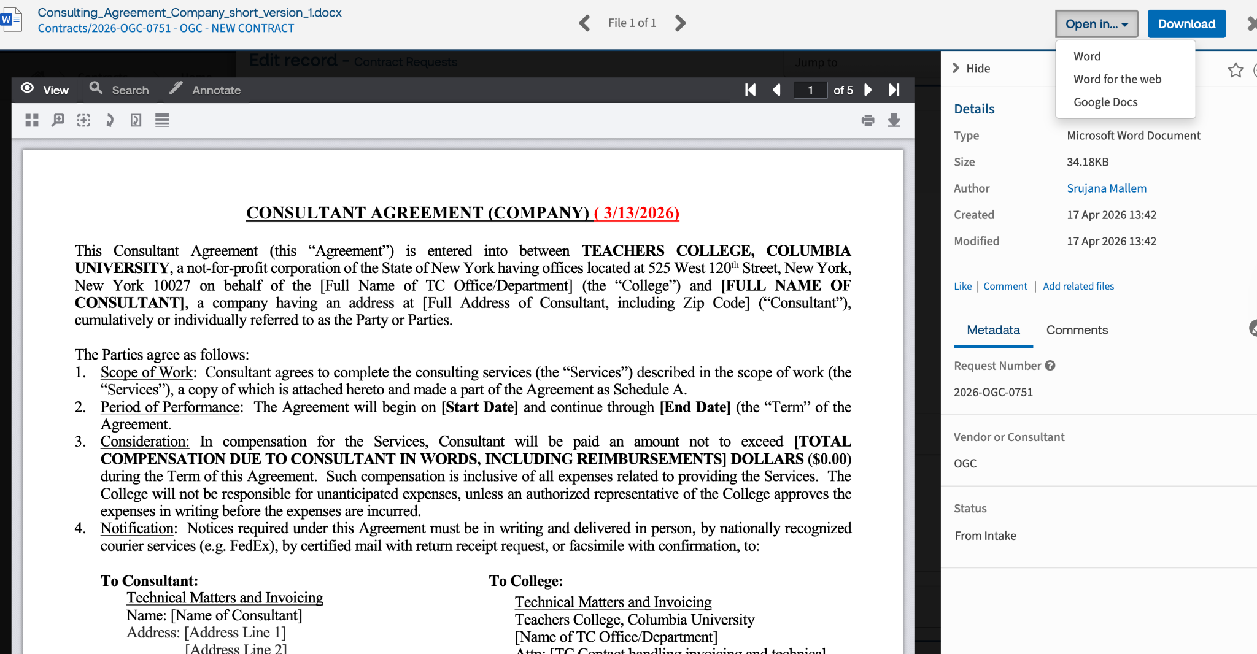
Select the Drop-down menu next to ‘Open in..’ , then press ‘Word’

Slide 5
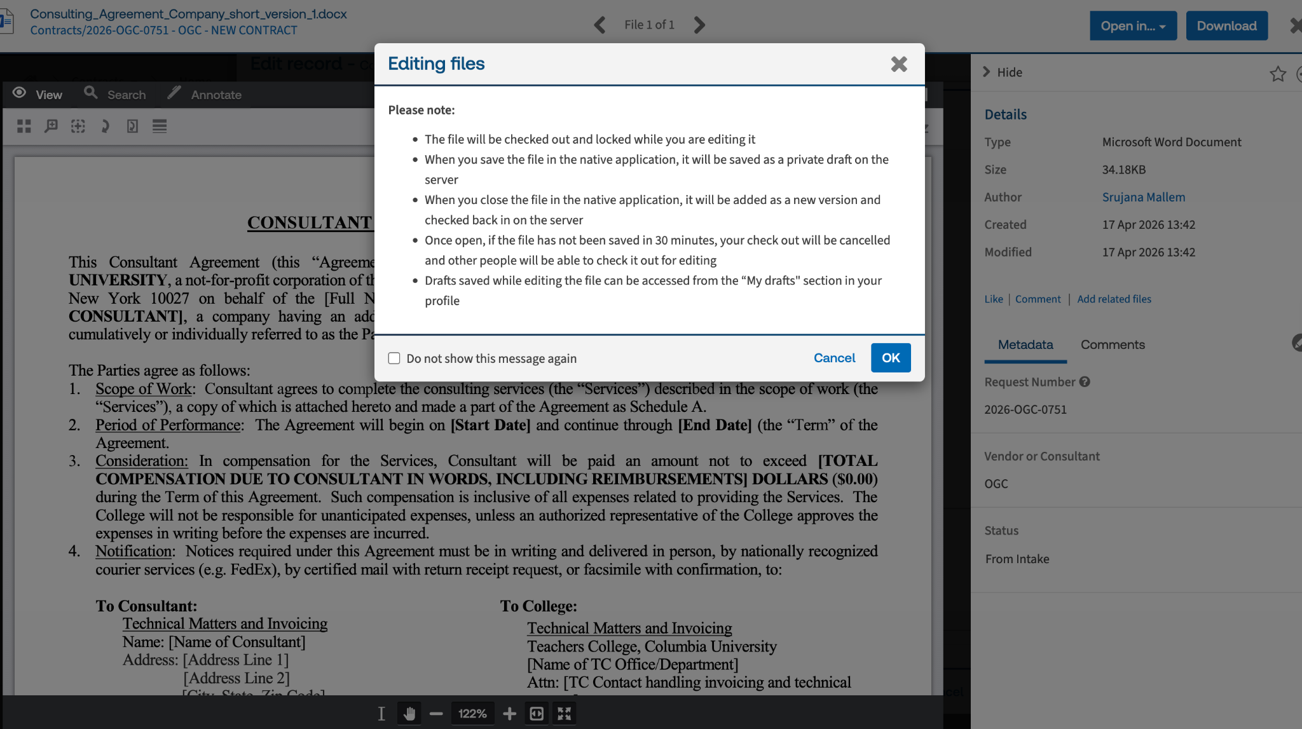
Press ‘OK’

Slide 6
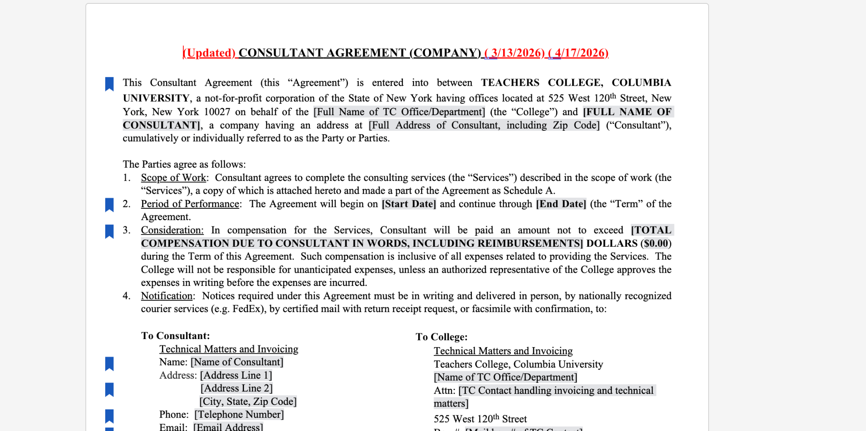
Make the necessary edits

Slide 7
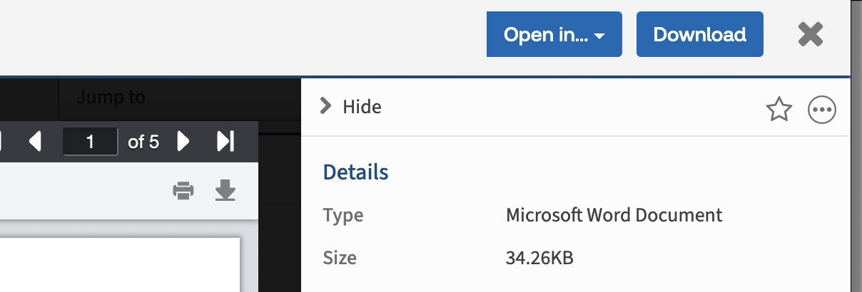
Select the X to close the document

Slide 8
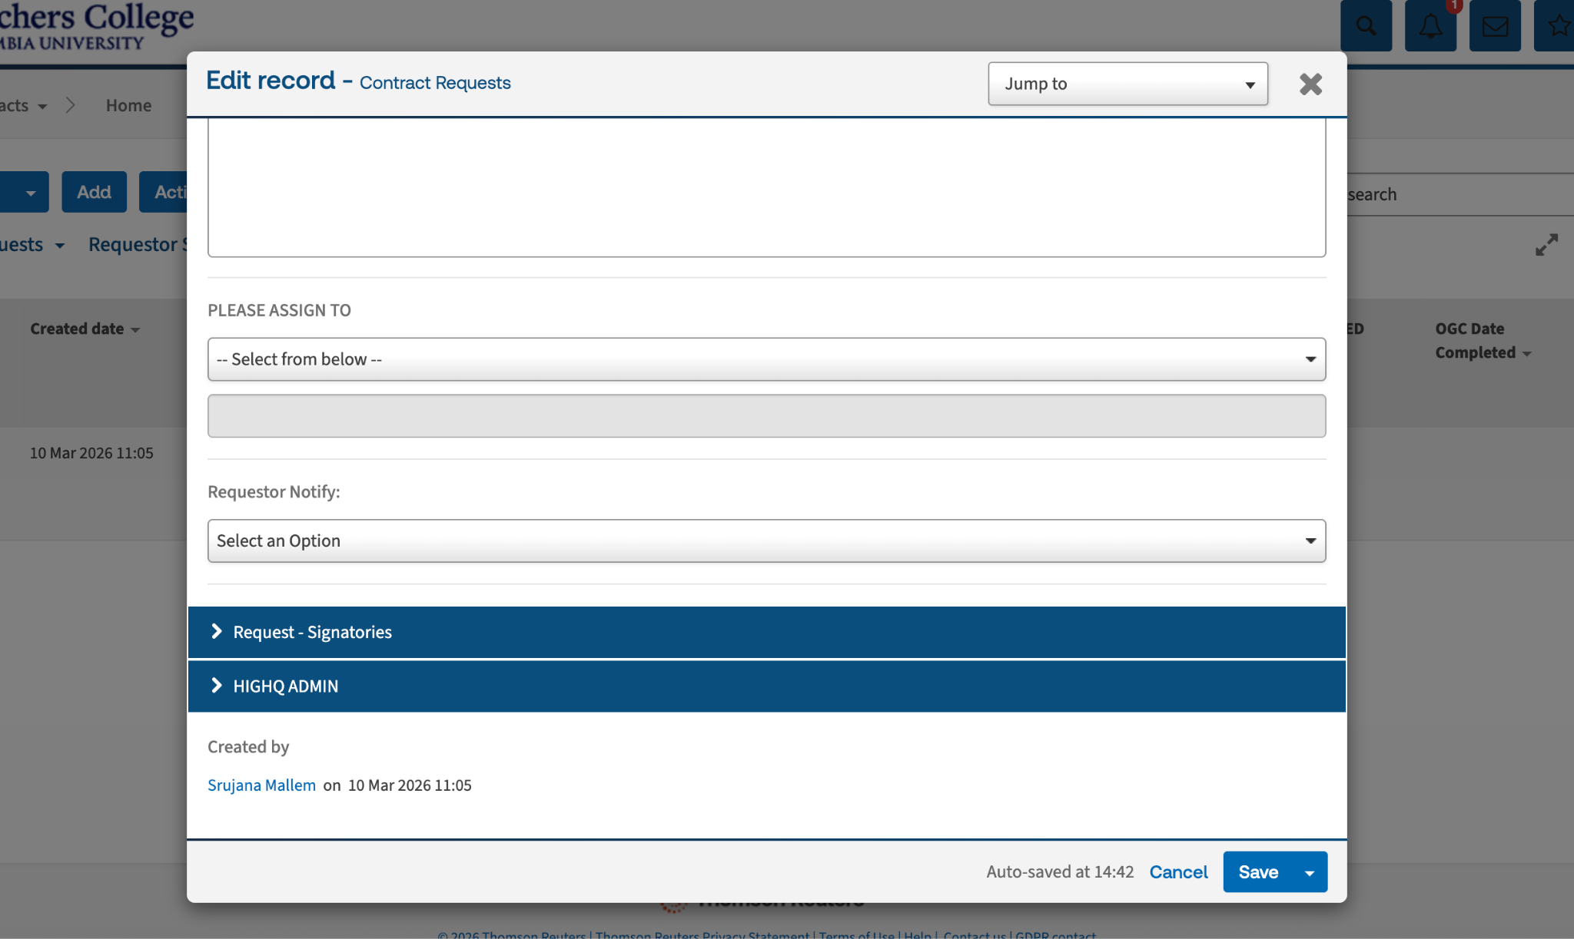
Save your Edits

Slide 9
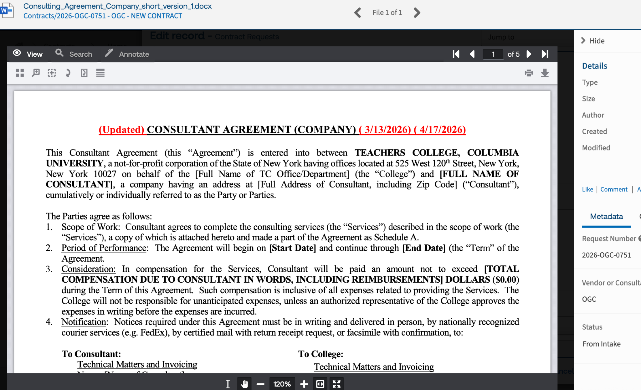
If you go to Edit → Request General → Attach Documents → Open the document, you will see the edited version

