Slide 1
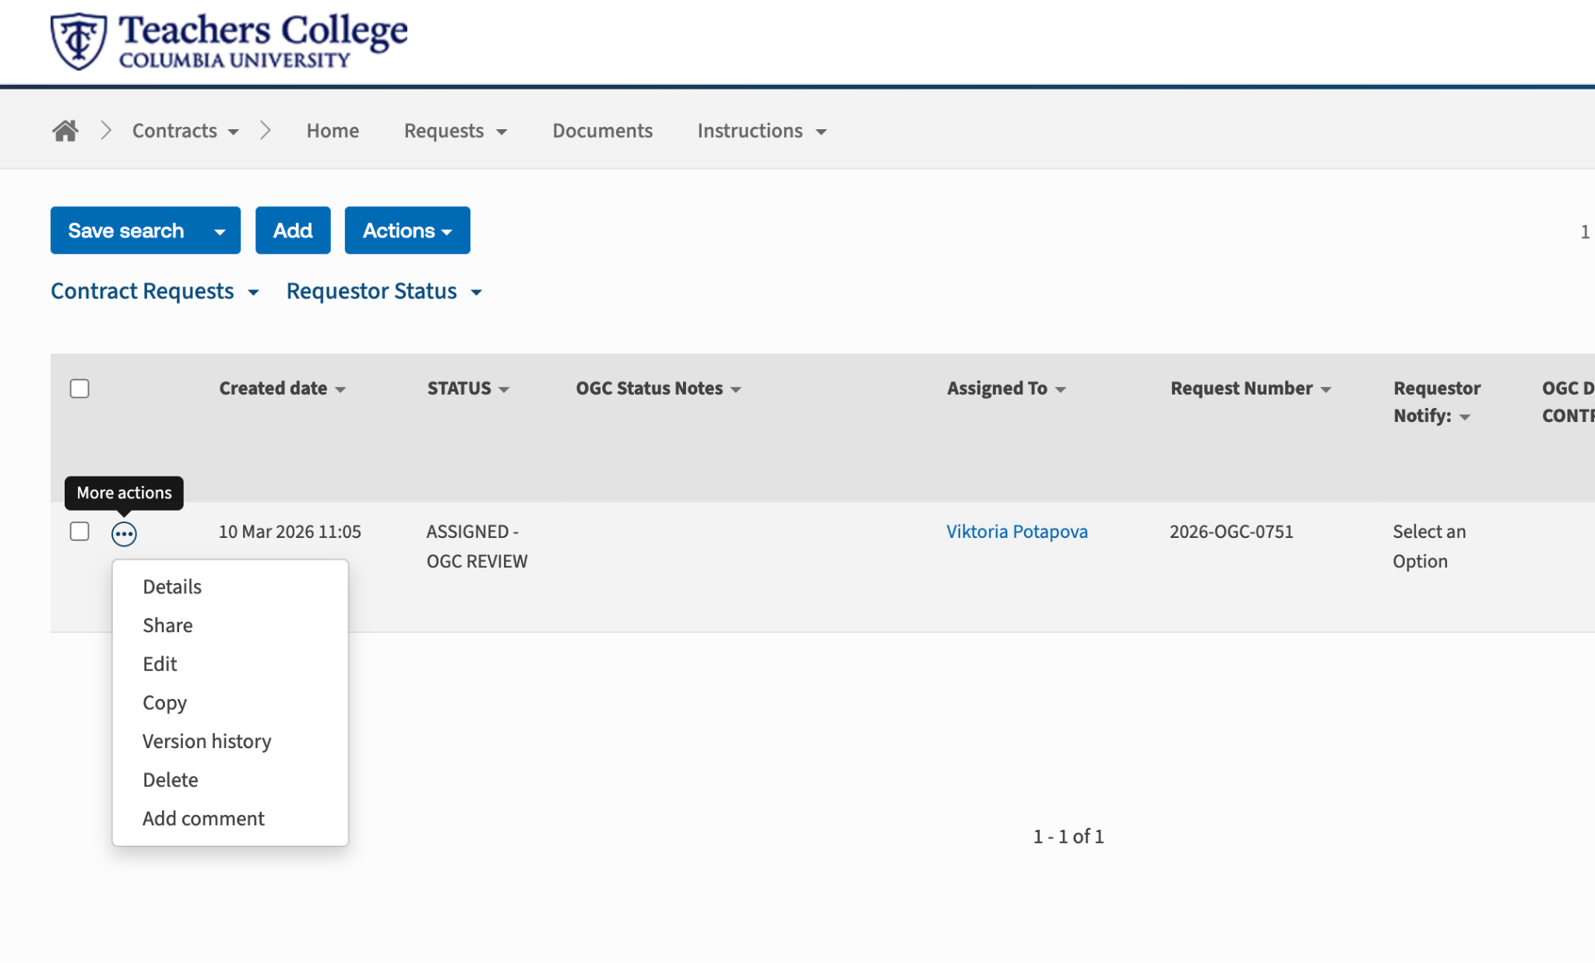
Select the 3 dots and press ‘Edit’

Slide 2
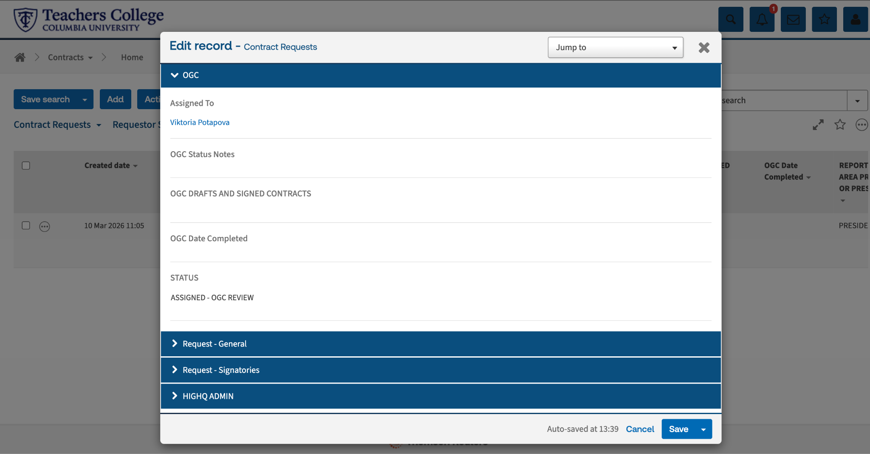
Select ‘Request General’

Slide 3
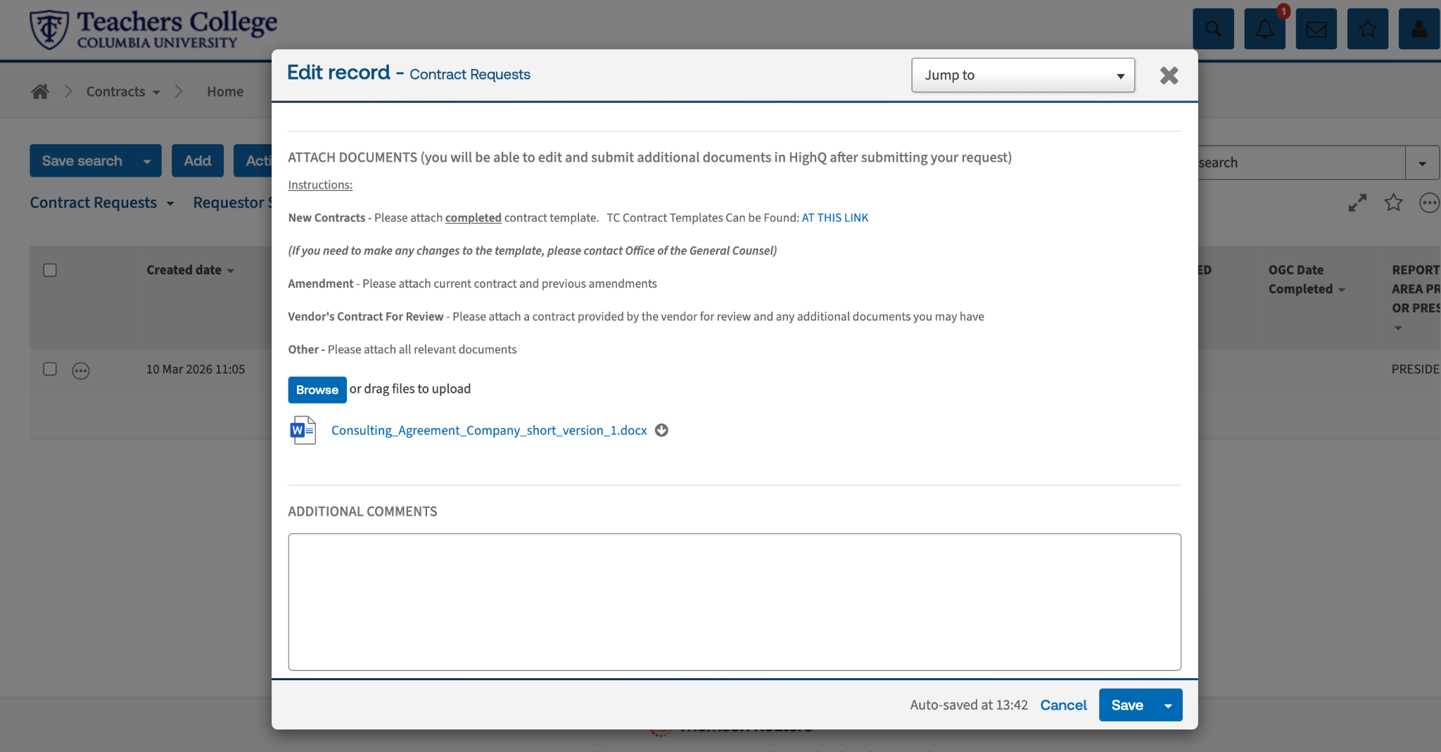
Scroll to ‘Attach Documents’, then click on ‘Browse’ to attach the new file

Slide 4
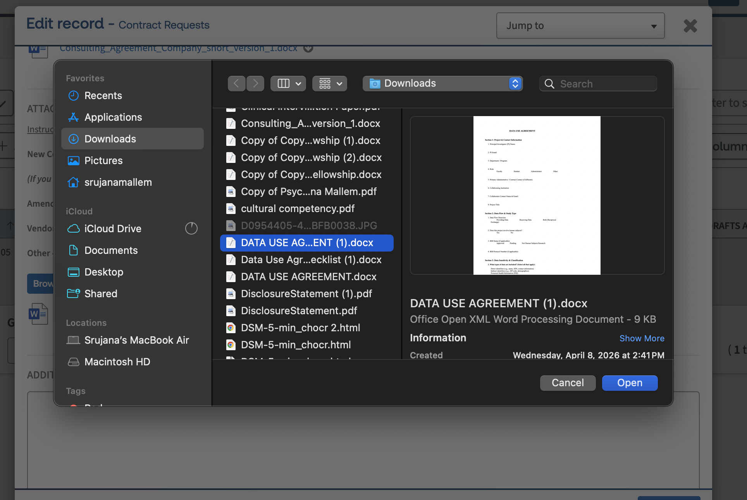
Select the document you wish to upload
Select ‘Open’

Slide 5
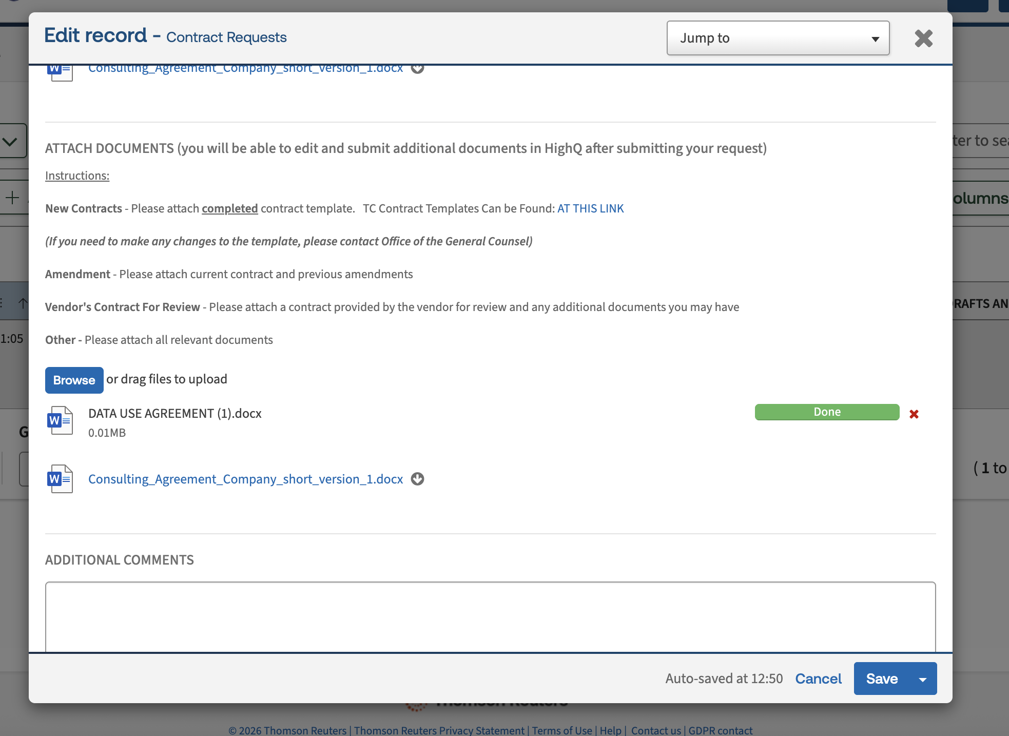
Wait for the document to finish uploading
Select ‘Save’

Slide 6
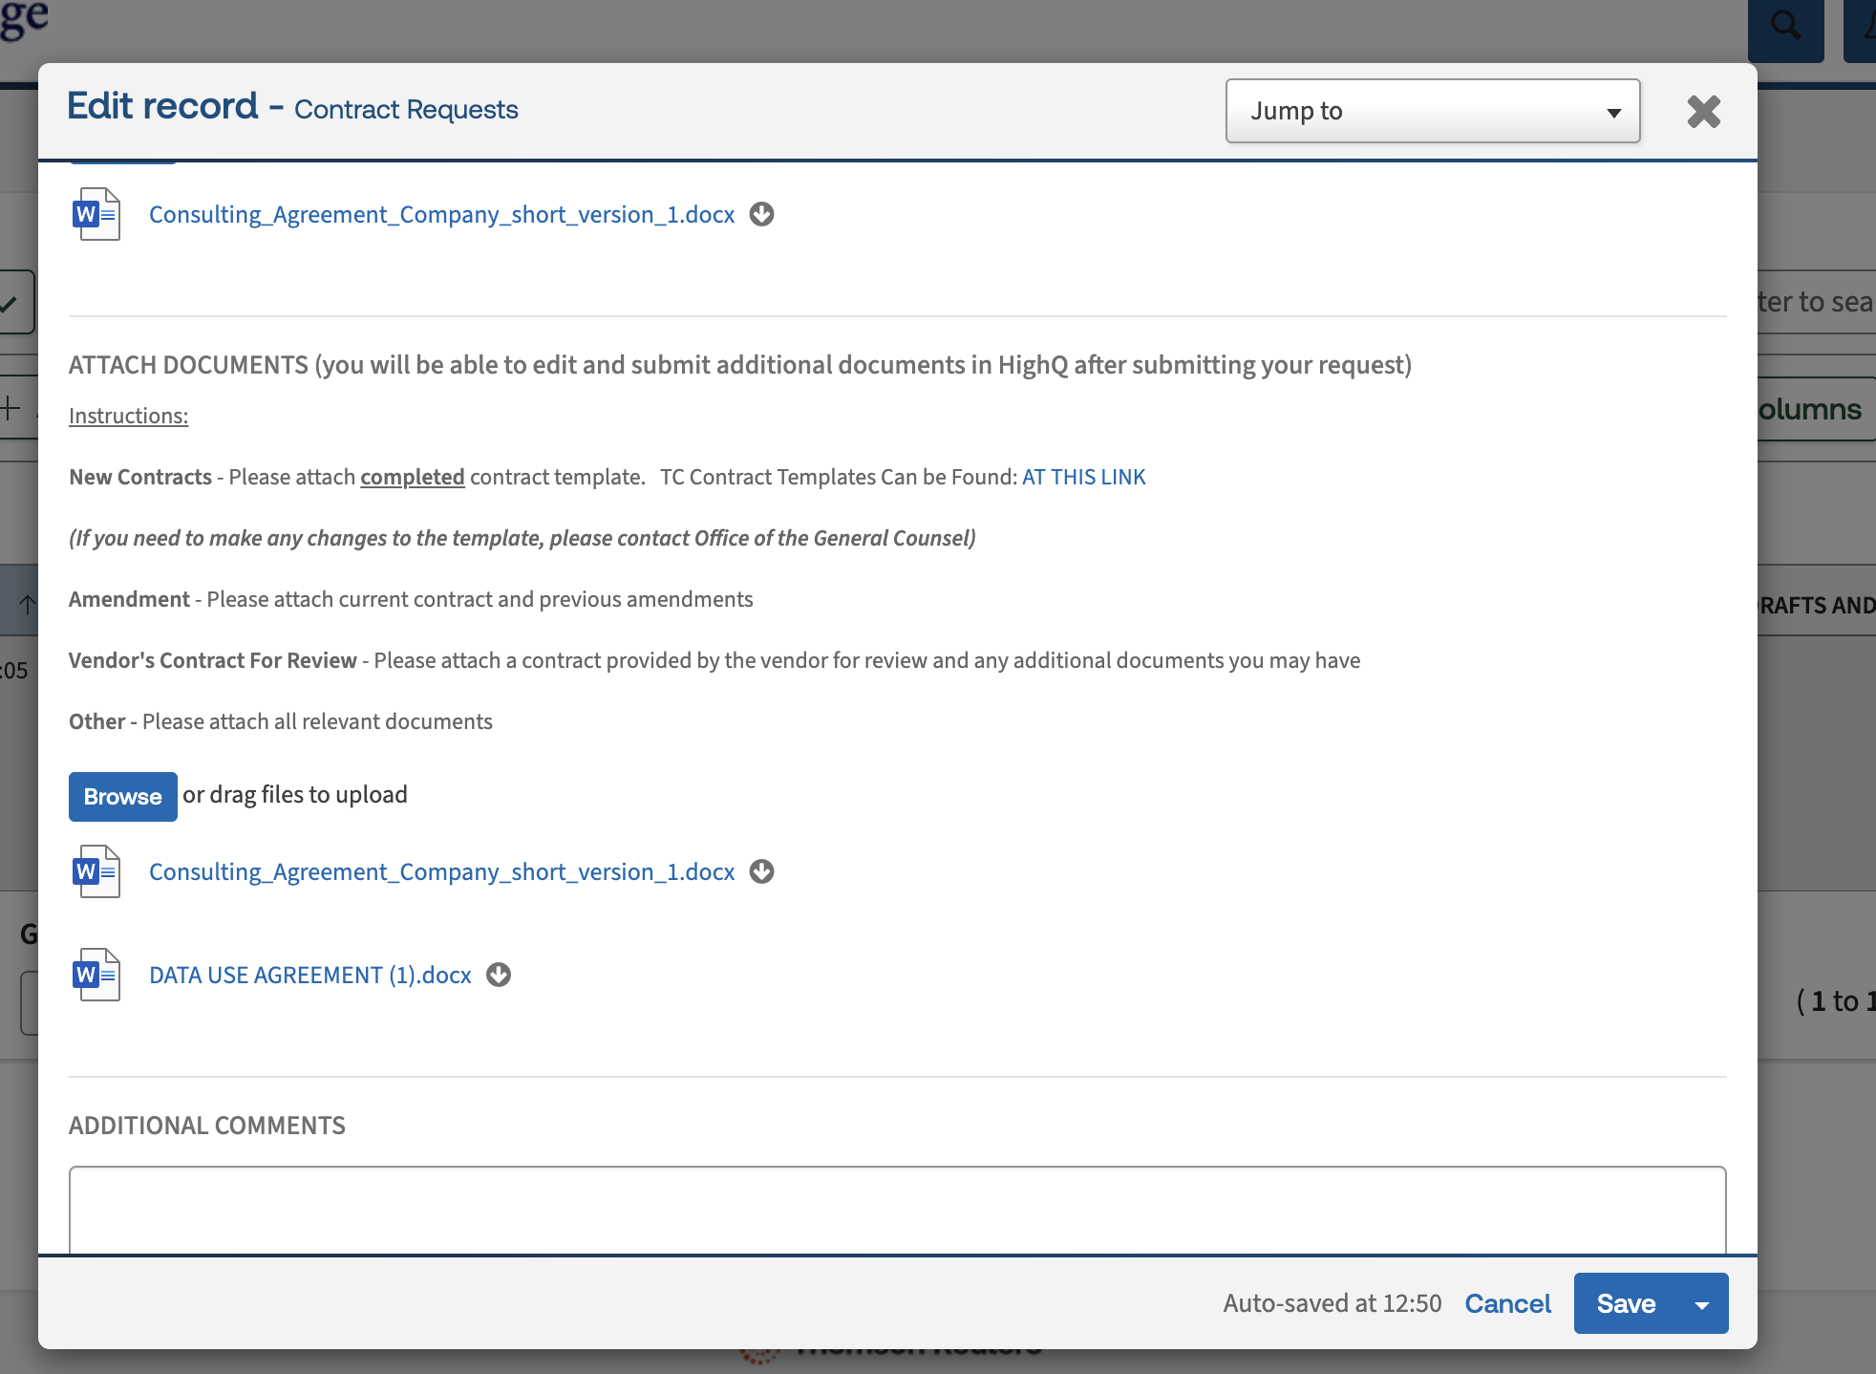
If you go to Edit → Request General→ Attach Documents→ You will see the newly added Document

